Slide 1
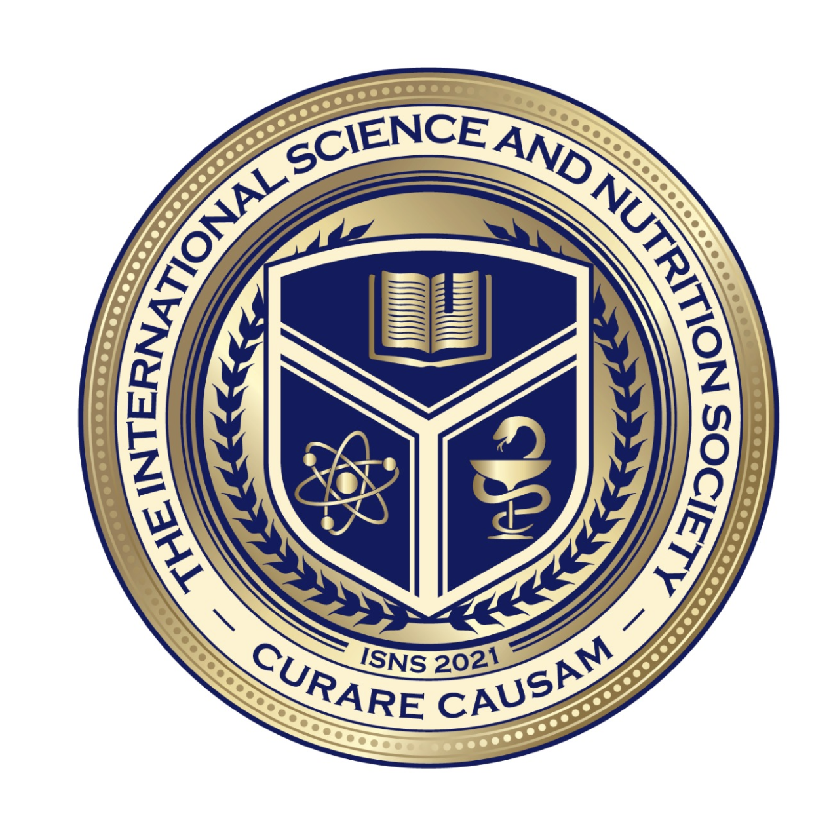
We will get started shortly.

Slide 2
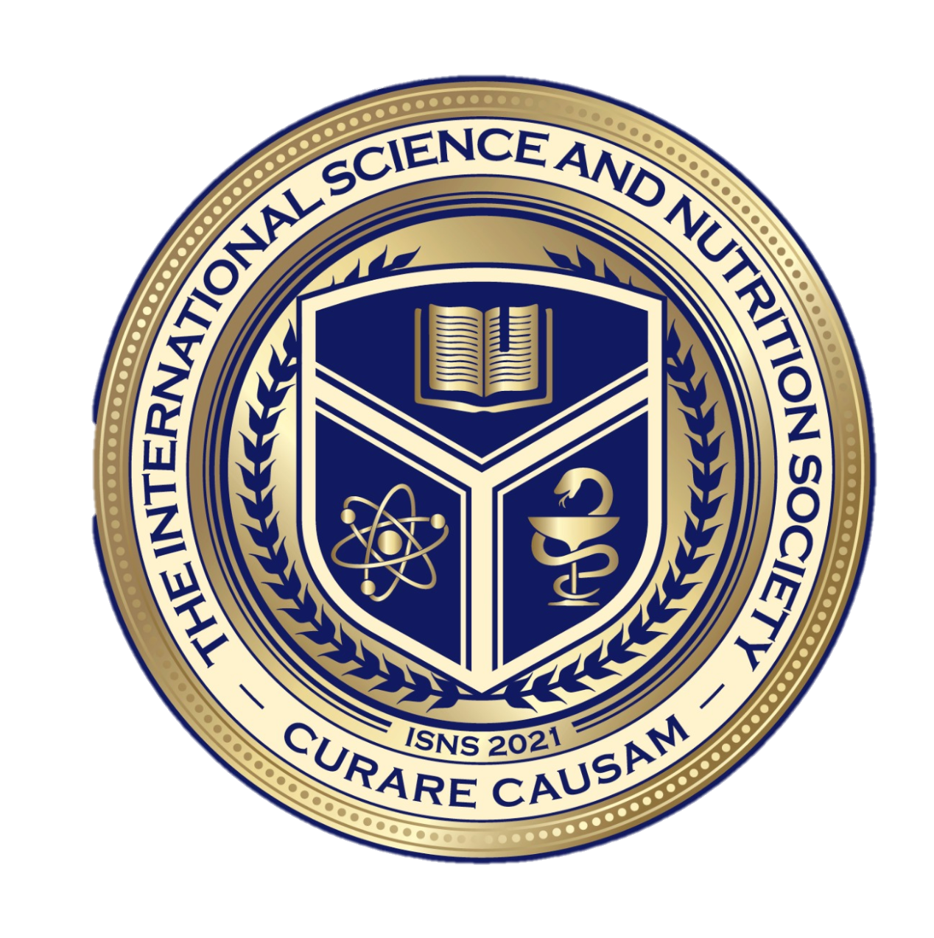
ISNS CASE STUDY
Hypothyroidism
Presented By: Norbert Ketskes
International Science Nutrition Society – CURARE CAUSAM - ISNS 2023

Slide 4
Medical Disclaimer:
The information provided is for educational purposes and is not intended as medical advice, or a substitute for the medical advice of a physician or other qualified health care professional. This is for science and educational purposes only and cannot be used in any aspect for sales or marketing. You should not use this information for diagnosing a health or fitness problem or disease. You should always consult with a doctor or other health care professional for medical advice or information about diagnosis and treatment. This is Confidential. Do not distribute—for scientific educational purposes only.
Notes:
The information provided is for educational purposes and is not intended as medical advice, or a substitute for the medical advice of a physician or other qualified health care professional. This is for science and educational purposes only and cannot be used in any aspect for sales or marketing. You should not use this information for diagnosing a health or fitness problem or disease. You should always consult with a doctor or other health care professional for medical advice or information about diagnosis and treatment. This is Confidential. Do not distribute—for scientific educational purposes only.

Slide 5
DR. NORBERT KETSKÉS, MD
Dr. Norbert Ketskés M.D. is one the most acknowledged gastroenterologist in Hungary, specializing in natural and organic nutritional solutions, leading the well-known Primus Labor, a private clinic offering personalized nutritional advices to its patients.
Scientific Adviser of ISNS
Medical Partner of the Hungarian Olympic Committee since 2015
Member of the Medical board of Hungarian Karate Association since 2015
Leader of the Primus Labor Private Medical Clinic since 2013
Working as a Family Doctor 1999 – 2012
International Science Nutrition Society – CURARE CAUSAM - ISNS 2023

Slide 6
CSISZTU ZSUZSA
Television - Presenter, Anchor, Editor, Journalist and Sports Lawyer, Sport-diplomat
Spokesperson of the Giro d’Italia Grande Partenza, (Road-Cycling World -Tour Championship)
Spokesperson of the FINA (Swimming and Waters poets World Championship)
2022 Vice-President of the Hungarian Sports Journalists’ Association
Member of the Hungarian Olympic Committee Member of the Advisory Board of the Hungarian Olympic Academy
Newly Elected Vice-President of the International Sports Journalists Association, the first female ever in the field from her homeland, and third globally since 1924 (AIPS)
International Science Nutrition Society – CURARE CAUSAM - ISNS 2023

Slide 7
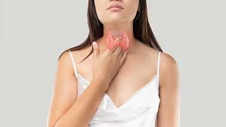
What is Hypothyroidism?
Hypothyroidism is a common condition where the thyroid does not create and release enough thyroid hormone into your bloodstream. This makes your metabolism slow down. Also called underactive thyroid, hypothyroidism can make you feel tired, gain weight and be unable to tolerate cold temperatures. The main treatment for hypothyroidism is hormone replacement therapy.
International Science Nutrition Society – CURARE CAUSAM -- ISNS 2023

Slide 8
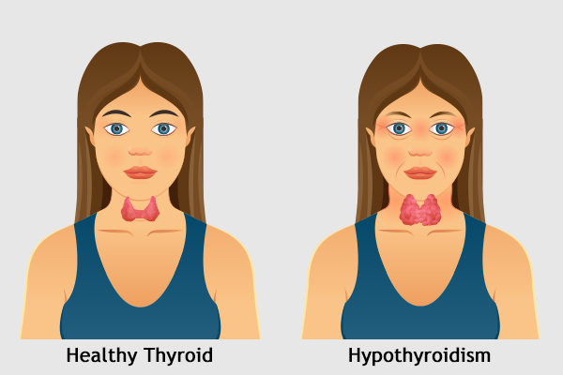
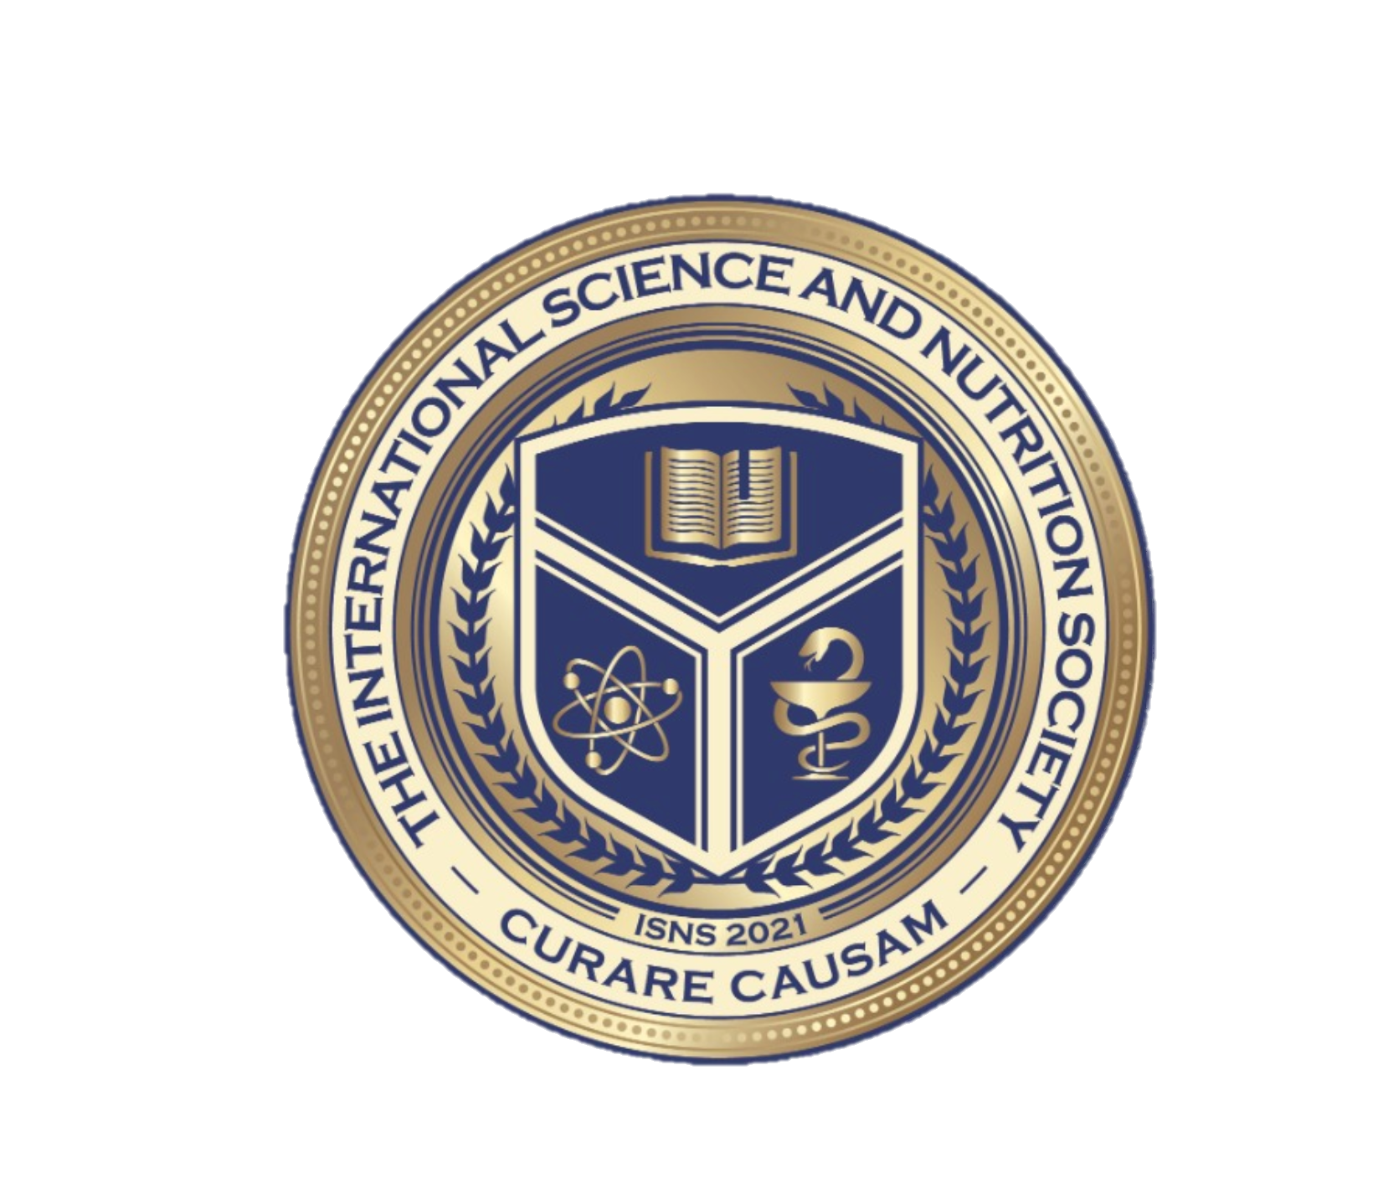
Hypothyroidism
Hypothyroidism may not cause noticeable symptoms in its early stages. Over time, hypothyroidism that is not treated can lead to other health problems, such as high cholesterol and heart problems.
Blood tests are used to diagnose hypothyroidism.
International Science Nutrition Society – CURARE CAUSAM -- ISNS 2023

Slide 9
How Does the Thyroid Work?
The thyroid gland is a small, butterfly-shaped organ located in the front of your neck.
The main job of the thyroid is to control your metabolism. Metabolism is the process your body uses to transform food to energy your body uses to function.
The thyroid created hormones T4 and T3 to control metabolism. These hormones work throughout the body to tell the body’s cells how much energy to use. They control body temperature and heart rate.
When the thyroid does not work correctly, it’s constantly making hormones to replace what’s being used. This keeps your metabolism functioning and all your body’s systems in check.
If the amount of thyroid hormones is too low, hypothyroidism is the result
International Science Nutrition Society – CURARE CAUSAM -- ISNS 2023

Slide 10
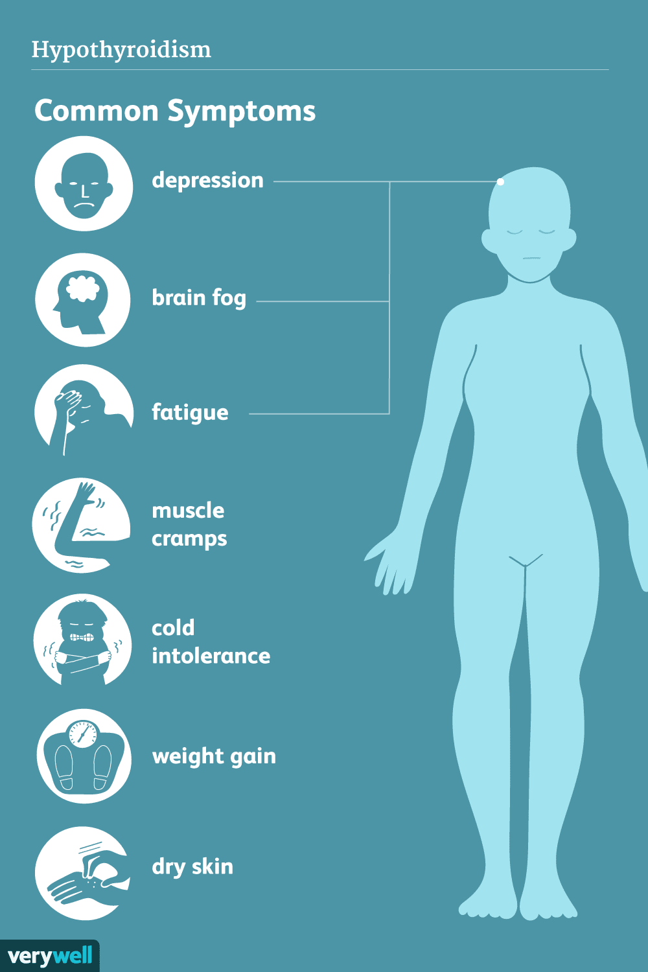
SYMPTOMS
The symptoms of hypothyroidism depend on the severity of the condition. Problems tend to develop slowly, often over several years.
At first, you may barely notice the symptoms of hypothyroidism, such as fatigue and weight gain. Or you may think they are just part of getting older. But as your metabolism continues to slow, you may develop more-obvious problems.
Hypothyroidism symptoms may include:
Tiredness
More sensitivity to cold
Constipation
Dry skin, puffy face, coarse hair or skin
Weight gain
Muscle weakness, muscle aches, tenderness, and stiffness
Thinning hair
Depression
Menstrual cycles that are heavier than usual
Memory problems
International Science Nutrition Society – CURARE CAUSAM -- ISNS 2023

Slide 11
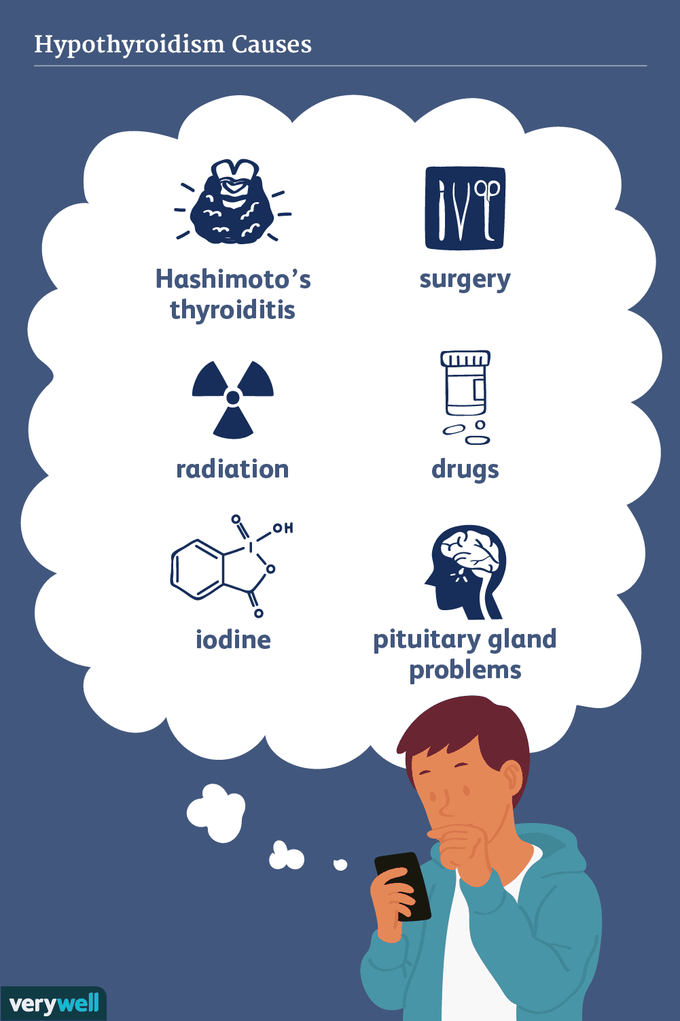
Causes of Hypothyroidism
Hypothyroidism can have a primary cause or a secondary cause.
A primary cause is a condition that directly impacts the thyroid and causes it to create low levels of thyroid hormones.
A secondary cause is something that causes the pituitary gland to fail, which means it can’t send thyroid stimulating hormone (TSH) to the thyroid to balance out the thyroid hormones.
Primary causes of hypothyroidism are much more common. The most common of these primary causes is an autoimmune condition called Hashimoto’s disease.
Also called Hashimoto’s thyroiditis or chronic lymphocytic thyroiditis, this condition is hereditary.
In Hashimoto’s disease, the body’s immune system attacks and damages the thyroid. This prevents the thyroid from making and releasing enough thyroid hormone.
Other primary causes of hypothyroidism can include:
Thyroiditis (inflammation of the thyroid)
Treatment of hyperthyroidism (radiation and surgical removal of the thyroid)
Iodine deficiency (not having enough iodine - a mineral the thyroid uses to make hormones
Hereditary conditions
International Science Nutrition Society – CURARE CAUSAM -- ISNS 2023

Slide 12
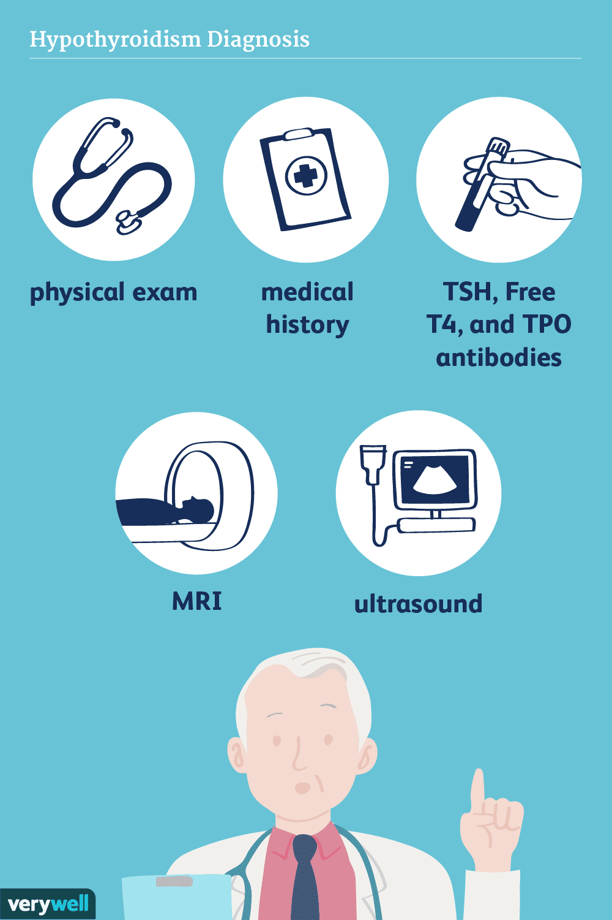
Hypothyroidism Diagnosis
The symptoms of hypothyroidism can be different from person to person. They can often look like symptoms of other health problems. Because of that, a diagnosis of hypothyroidism doesn’t rely on symptoms alone. It is usually based on the results of blood tests
The first blood test is typically done to diagnose hypothyroidism and measures the level of thyroid-stimulating hormone (TSH) in the blood. If it’s high, the test is done again, along with a blood test for thyroid hormone T-4. If the results show that TSH is high and T-4 is low, then the diagnosis is hypothyroidism. In some cases, the thyroid hormone T-3 may be measured as well.
If the second test shows high TSH but T-4 and T-3 are in the standard range, then the diagnosis is a condition called subclinical hypothyroidism. It usually doesn’t cause any noticeable symptoms.
International Science Nutrition Society – CURARE CAUSAM -- ISNS 2023

Slide 13
CASE STUDY
Patient:Female
Age: 36
History: Her mother was diagnosed with hypothyroidism when she was in her 50s.
Medical history:
She was diagnosed with Hypothyroidism, (Hashimoto’s thyroiditis) 6 months ago.
Symptoms: Fatigue, weight gain, constipation, thinning hair, hair loss, cold
intolerance, depression and problems in the menstrual cycles.
Lab tests:
TSH: 7,38 mikroIU/ml (norm. range:0.35-4.94)
T4: 6,08 ng/dl (norm. Range: 9.01-19.05)
T3: 2.05 pg/ml (norm.range: 2.43-6.01)
Anti TPO: 283,5 U/ml (norm. Range: <5.61)
International Science Nutrition Society – CURARE CAUSAM - ISNS 2023

Slide 14
Conventional Treatment
Treatment for hypothyroidism usually includes taking the thyroid hormone medicine levothyroxine (Levo-T, Synthroid, others) every day. This medicine is taken by mouth. It returns hormone levels to a healthy range, eliminating symptoms of hypothyroidism. You will likely start to feel better one or two weeks after you begin treatment. Treatment with levothyroxine will be lifelong. Because the dosage you need may change, your health care provider may check your TSH level each year.
If you are diagnosed with subclinical hypothyroidism, talk about treatment with your health care provider. For a mild rise in TSH, thyroid hormone medicine may not be useful. If your TSH level is higher, but still in the subclinical range, thyroid hormones may improve some symptoms.
She was started on levothyroxine medication.
L-thyroxin: 100 mikrogramm/day
International Science Nutrition Society – CURARE CAUSAM - ISNS 2023

Slide 15
Method
PROPRIETARY BLENDS LEGEND
Proprietary Blend I: Silica, Vitamin C, and Trace Minerals
Proprietary Blend II: N-acetyl L-tyrosine, Anhydrous Caffeine, L-theanine, Velvet Bean Seed, Pine Bark, Curcumin, and Vitamin D
Proprietary Blend III: Black seed oil, Resveratrol, turmeric, Raspberry Ketones, Apple Cider Vinegar, Aloe Vera, and D-Ribose
Proprietary Blend IV: Vitamin C, zinc sulfate, and vitamin D3
Proprietary Blend V: Inulin, Green Banana flour, apple fiber, bacillus coagulans, spirulina, wheat grass, barley grass, alfalfa leaf, flax seed, psyllium husk powder, chlorella, broccoli, kale, spinach, green cabbage, parsley, aloe vera, cayenne pepper, blueberry powder, pomegranate seed powder, and MCT coconut oil powder
Proprietary Blend VI: Vitamin K2, Vitamin D3, Vitamin C, Magnesium oxide, OmniMin AC (trace mineral blend) Quercetin, and NAD
Proprietary Blend VII: Bovine collagen and hydrolyzed bovine colostrum
Proprietary blend I: 2x3 drops, morning and
evening, for 3 days, then every 3 days then
increased by 1-1 drops every 3 days to 2x10
Proprietary blend II :1 in the morning for 7 days,
then 2, 1 in the morning and 1 in the afternoon
Proprietary blend III: 1/2 sachet in the morning
for 7 days then 1 sachet in the morning for 7 days
then 1 sachet in the morning and 1 sachet in the
evening
Proprietary blend IV: 1/2 teaspoon in the
morning
Proprietary blend V: 1 teaspoon in the
in the evening for 7 days, then 1,5 teaspoon in the
evening
Proprietary blend VI: 1 in the
morning for 7 days then 1 in the morning and 1 in
the evening
International Science Nutrition Society – CURARE CAUSAM - ISNS 2023

Slide 16
Additional Treatment
Exercises to achieve a positive mental and emotional state
(e.g: Yoga, meditation, breathing exercises, stress management, regular exercise and adequate sleep)
Gluten-free and selenium-rich diet ( e.g.:fish, other seafood)
International Science Nutrition Society – CURARE CAUSAM - ISNS 2023

Slide 17
Results
After 1 month:
She noticed an improvement in her energy levels and was able to lose some of the weight she had gained. Her constipation also improved, and she no longer felt cold all the time.
After 3 months:
Her symptoms gradually continued to improve.
Her energy levels continued increased, she experienced less hair loss, and her mood lifted.
The functioning of the digestive system has returned to normal
Menstrual cycles has returned to normal
Control Lab tests:
TSH: 4.91 (7,38 ) mikroIU/ml (norm. range:0.35-4.94)
T4: 11.21 (6,08) ng/dl (norm. Range: 9.01-19.05)
T3: 3.81 (2.05) pg/ml (norm.range: 2.43-6.01)
Anti TPO: 76.8 (283,5) U/ml (norm. Range: <5.61)
International Science Nutrition Society – CURARE CAUSAM - ISNS 2023

Slide 18
Thyroid dysfunction: how concentration of toxic and essential elements contribute to risk of hypothyroidism, hyperthyroidism, and thyroid cancer Maryam Rezaei, Seyed Yoosef Javadmoosavi, Borhan Mansouri, Nammam Ali Azadi, Omid Mehrpour, Samaneh Nakhaee
This study was conducted to evaluate the levels of trace metals Fe, Cr, Co, Cd, Cu, Ni, Hg, Zn, and Pb in healthy individuals and patients with thyroid disease (hyperthyroidism, hypothyroidism, and cancerous).
Results showed that the concentration levels of Cr, Co, Zn, Cd, and Pb were significantly higher in case-patients (p < 0.05), but the levels of Fe, Ni, and Hg were similar between healthy and patient subjects (p > 0.05).
In conclusion, our findings suggest that toxic metals such as Pb, Cd, and Cr can increase the risk of developing hypothyroidism and thyroid cancer.
https://pubmed.ncbi.nlm.nih.gov/31701424/
International Science Nutrition Society – CURARE CAUSAM -- ISNS 2023

Slide 19
Effect of zinc supplementation on thyroid hormone function. A case study of two college females Christy Maxwell, Stella Lucia Volpe
Zinc is crucial for proper thyroid hormone metabolism; zinc deficiency may result in decreased thyroid hormone levels and resting metabolic rate (RMR). The purpose of this investigation was to assess the effects of zinc supplementation on plasma zinc, serum ferritin, plasma total triiodothyronine (T(3)) and thyroxine (T(4)), serum free T(3) and T(4), and thyroid-stimulating hormone concentrations, and RMR in zinc-deficient, physically active women.
Zinc-deficient female college students (ZD1 and ZD2) were supplemented with 26.4 mg/day of zinc (as zinc gluconate), and the above parameters were analyzed at 0, 2 and 4 months.
Zinc supplementation appeared to be directly responsible for the increase in plasma zinc and decline in serum ferritin concentrations in both subjects. Zinc supplementation appeared to have a favorable effect on thyroid hormone levels, particularly total T(3), and RMR.
https://pubmed.ncbi.nlm.nih.gov/17541266/
International Science Nutrition Society – CURARE CAUSAM -- ISNS 2023

Slide 20
Vitamin D Deficiency and Its Association with Thyroid Disease Dr. Amal Mohammed Husein Mackawy, Bushra Mohammed AI-ayed, and Bashayer Mater AI-rashidi
Vitamin D deficiency is a global health problem, and its role as an immune modulator has been recently emphasized. The evidence is increasingly pointing towards vitamin D’s significant role in reducing the incidence of autoimmune diseases.
We aimed to examine the relationship between hypothyroidism and vitamin D deficiency and to clarify the relationship between serum calcium levels with hypothyroid disease.
Serum vitamin D (25-OH) levels were measured in 30 patients with hypothyroidism and 30 healthy subjects, utilizing the spectrophotometric method. Vitamin D deficiency was designated at levels lower than 20 ng/ml. Thyroid hormones (TSH, T3, and T4) and calcium levels were evaluated in all participants.
Serum 25(OH) vit D was significantly lower in hypothyroid patients than in controls (t=−11.128, P =0.000). Its level was insignificantly decreased in females than in male patients (t=− 1.32, P >0.05). Moreover, serum calcium levels recorded a significant decrease in hypothyroid patients when compared to controls (t= −5.69, P = 0.000).
Our results indicated that patients with hypothyroidism suffered from hypovitaminosis D with hypocalcemia which is significantly associated with the degree and severity of the hypothyroidism. That encourages the advisability of vit D supplementation and recommends the screening for Vitamin D deficiency and serum calcium levels for all hypothyroid patients.
https://www.ncbi.nlm.nih.gov/pmc/articles/PMC3921055/
International Science Nutrition Society – CURARE CAUSAM -- ISNS 2023

Slide 21
References
https://my.clevelandclinic.org/health/diseases/12120-hypothyroidism
https://pubmed.ncbi.nlm.nih.gov/31701424/
https://pubmed.ncbi.nlm.nih.gov/17541266/
https://www.ncbi.nlm.nih.gov/pmc/articles/PMC3921055/
International Science Nutrition Society – CURARE CAUSAM -- ISNS 2023

Slide 22
Thank you for joining us today!
International Science Nutrition Society – CURARE CAUSAM -- ISNS 2023

